Slide 1
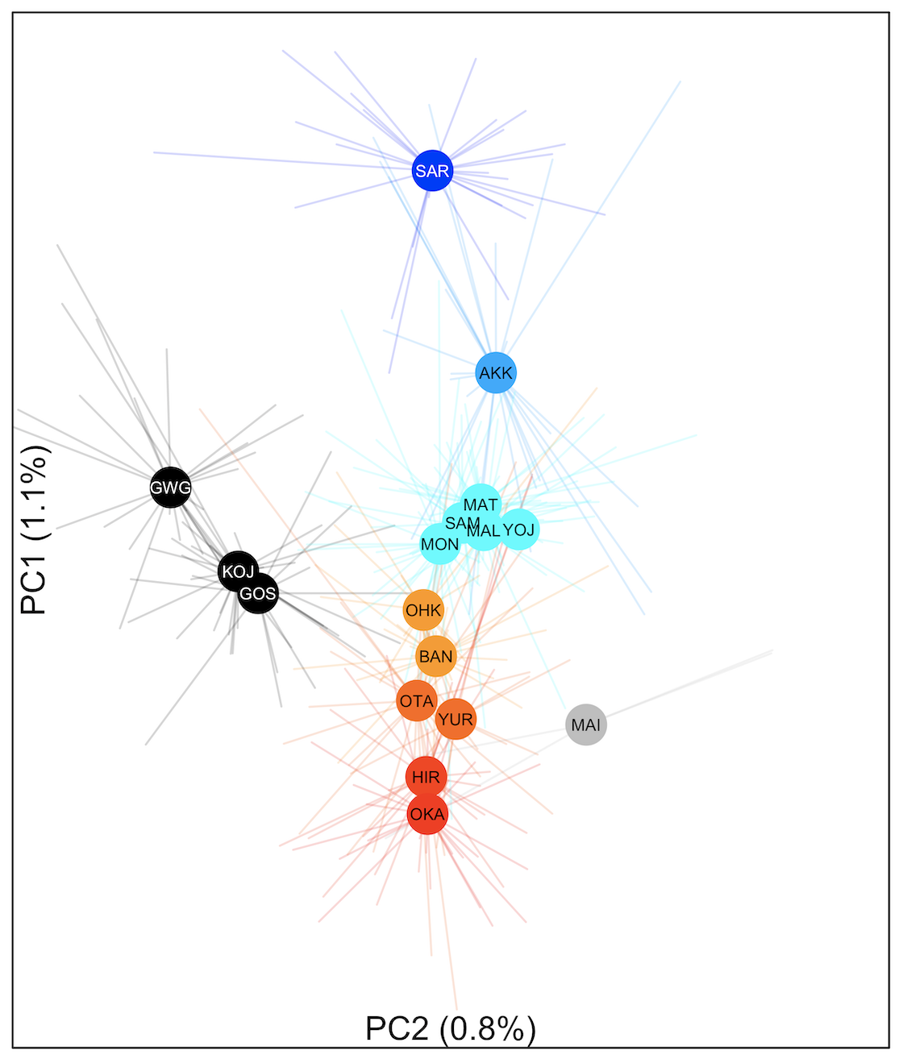
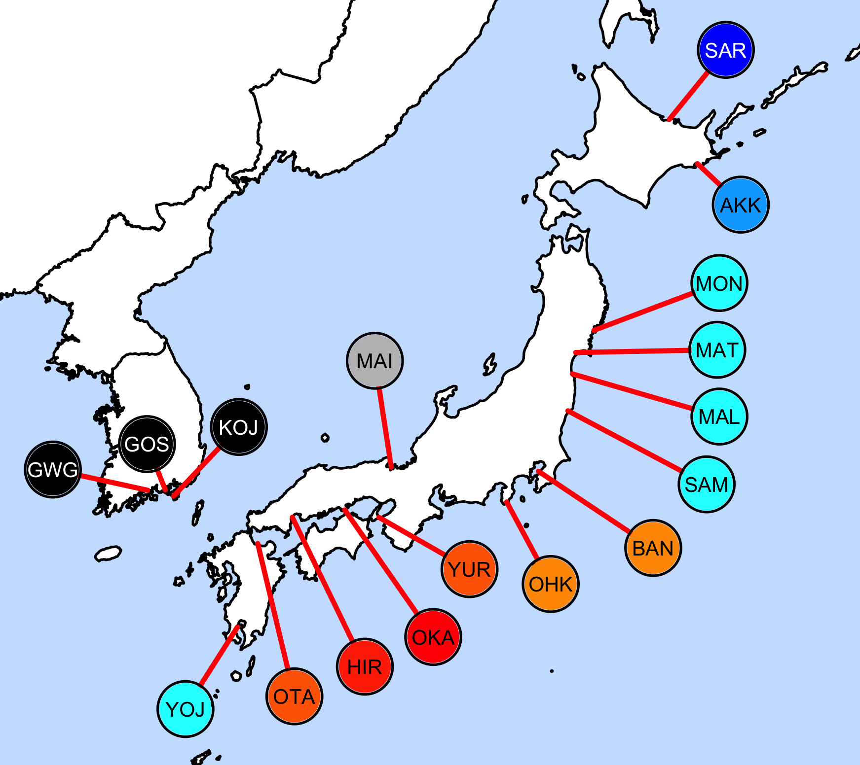
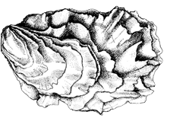
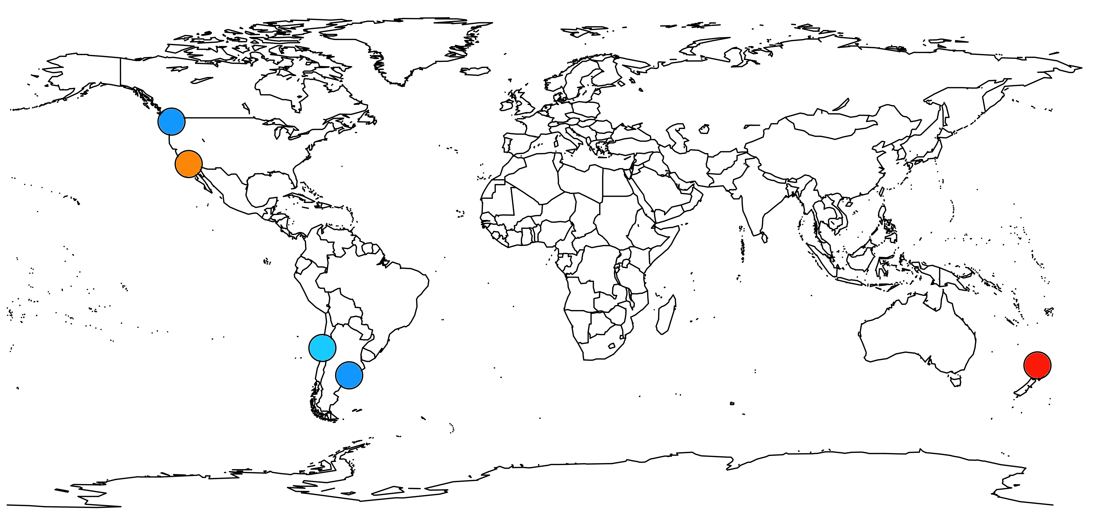
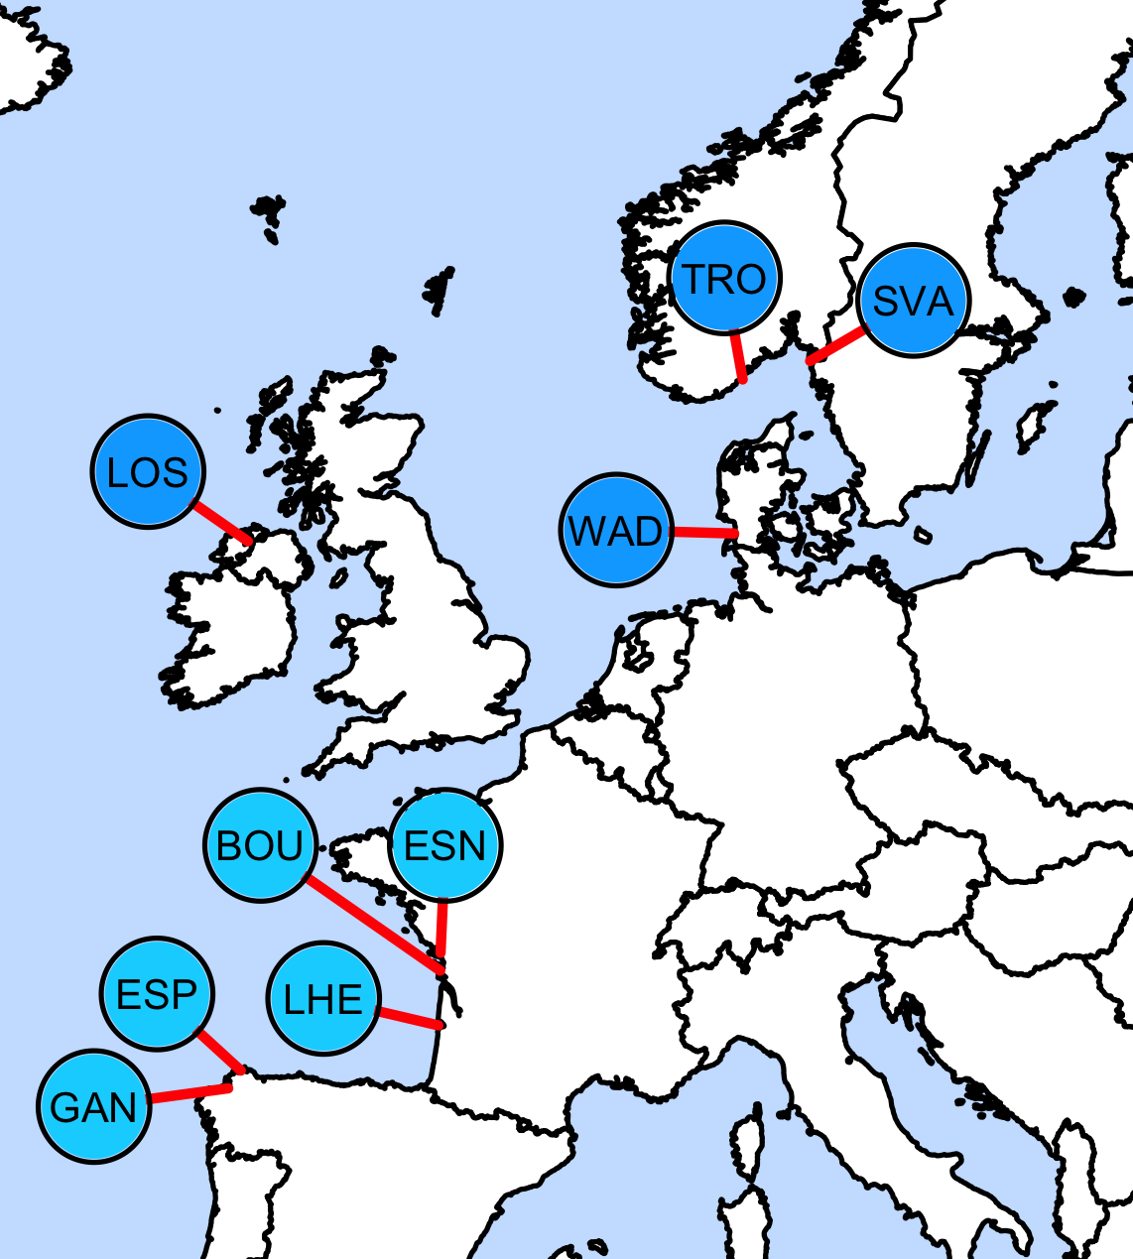
Figure 1. A) Principal components analysis (PCA) trained with native oysters from Korea and Japan. Population colors reflect a blue-to-red gradient from the 1st axis of the PCA. Populations are mapped onto geography in B) Japan and Korea and C) worldwide. Regional locations of three native oyster strains (sensu Imai and Sakai 1961) are indicated. Inset drawing reproduced with permission from FAO
A
B
Hokkaido
Miyagi
Hiroshima / Seto Inland Sea
C
Canada and WA
Europe
Native range
See B
California
Chile
Argentina
New Zealand

Slide 2
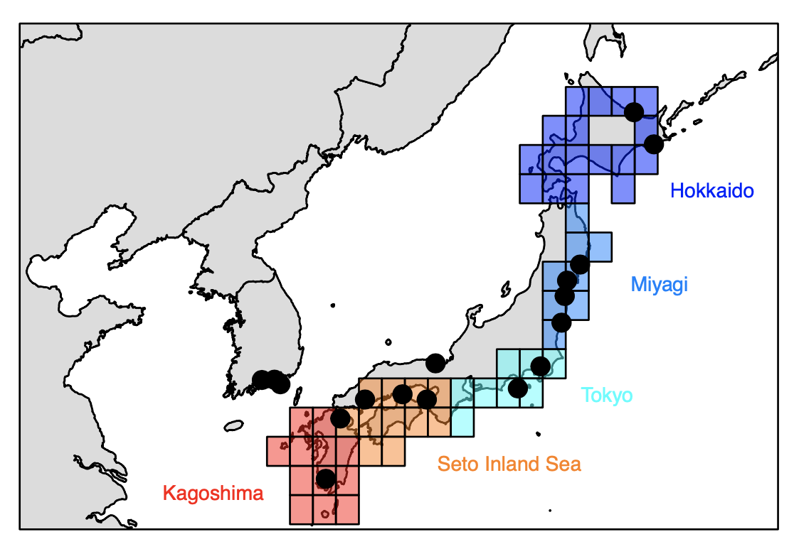
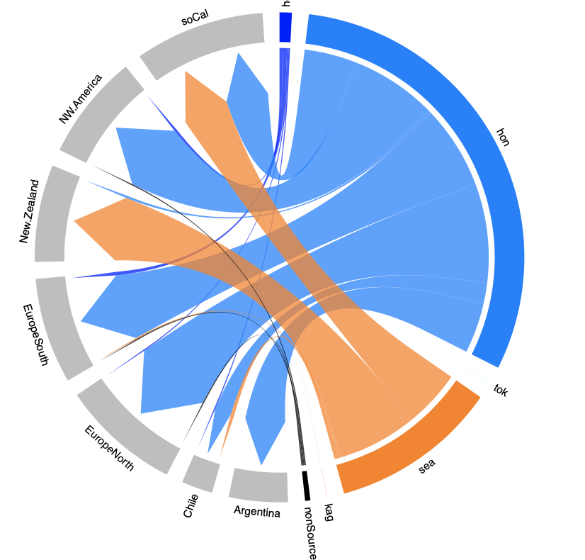
Tokyo
North America
California
CA, WA
Miyagi
New
Zealand
Sp, Fr
Europe
UK, De, G, Sw
South
America
Seto Inland
Sea
Ch
Arg
Figure 2. Top panel: Map of regions used for unsupervised machine learning. Bottom panel: A circlize plot that summarizes the native regions that non-native individuals most likely assign to. UK = United Kingdom, De = Denmark, G = Germany, Sw = Sweden, Sp = Spain, Fr = France, CA = Canada, WA = Washington State, Ch = Chile, Arg = Argentina.

Slide 3
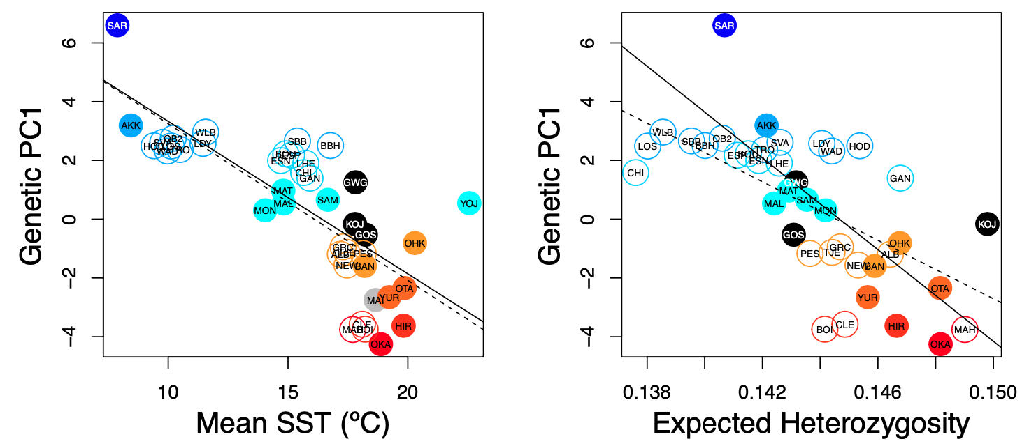
Figure 3. Genetic PC1 correlates with mean sea surface temperature (Native r = -0.777; df = 15; p< 0.001; Introduced r = -0.744; df = 22; p< 0.001) and with expected heterozygosity (Hs; Native r = -0.755, df = 13, p = 0.001; Introduced r = -0.634, df = 22; p < 0.001). Closed versus open circles represent native versus introduced populations, respectively. Population colors reflect a blue-to-red gradient of Genetic PC1 (Fig 1a).

Slide 4
Supplemental

Slide 5
Figure S2 – Principal components analysis (PCA) of 726 oysters using 7046 loci

Slide 7
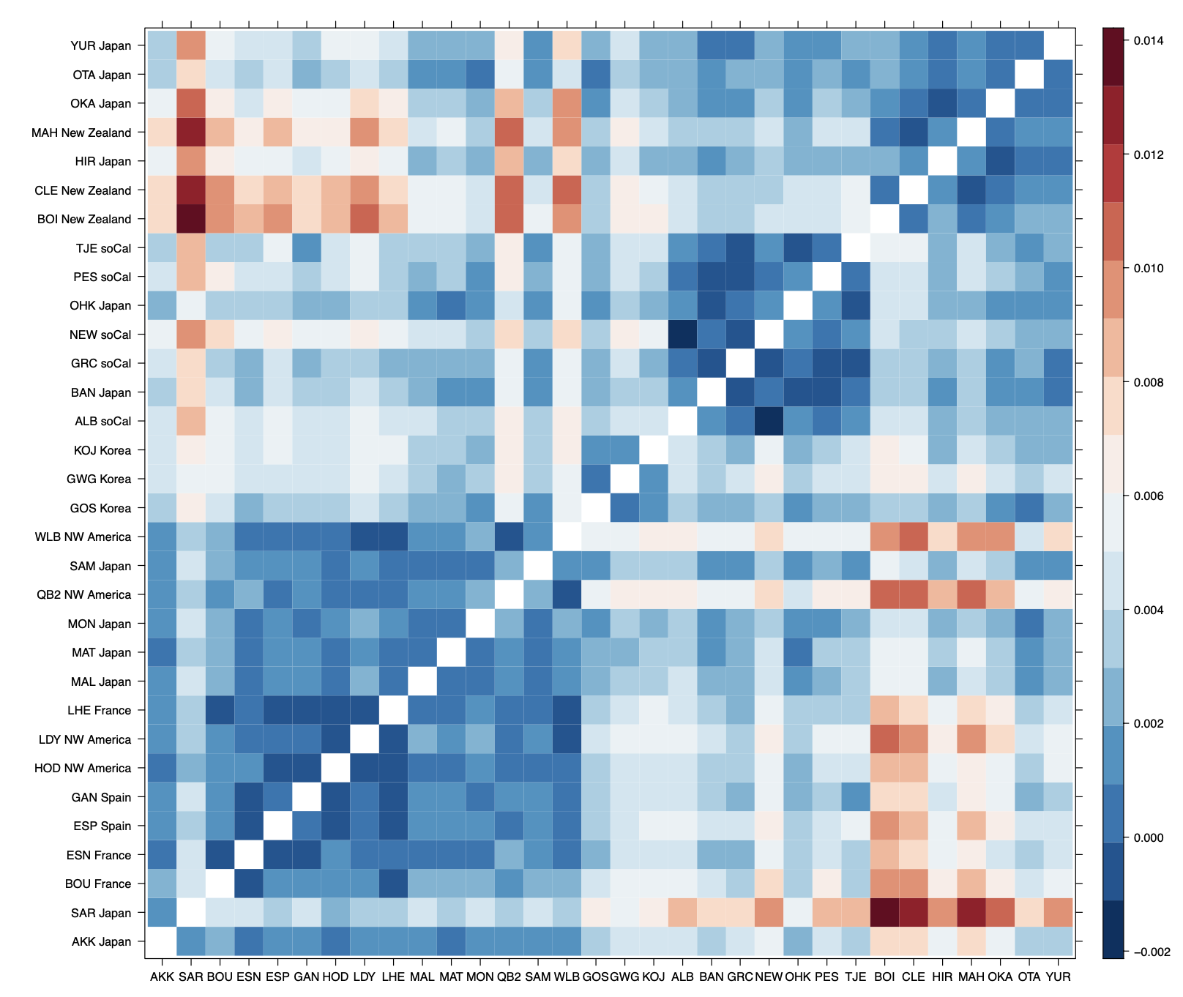
Figure S3 – Heatmap of pairwise Weir & Cockerham PhiSt. Dendrogram via of R::lattice::levelplot().
Southern Japan
New Zealand
Southern California
South Korea
Northern Japan
Canada
Washington State
Spain, France

Slide 8
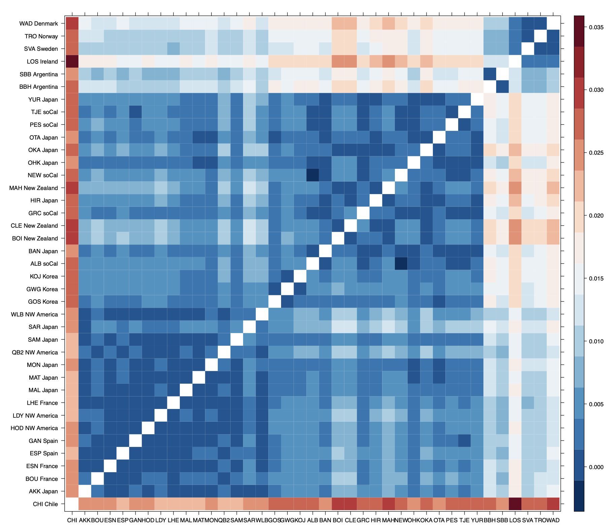
Figure S3 – Heatmap of pairwise Weir & Cockerham PhiSt. Dendrogram via of R::heatmap().
Argentina
Northern Europe
Southern Japan
New Zealand
Southern California
South Korea
Northern Japan
Canada
Washington State
Spain, France

Slide 9
Figure SX. Estimate Ne from linkage disequilibrium based on Pearson correlation approximation following Waples et al 2016. Estimated using strataG (Archer et al 2016).

Slide 10
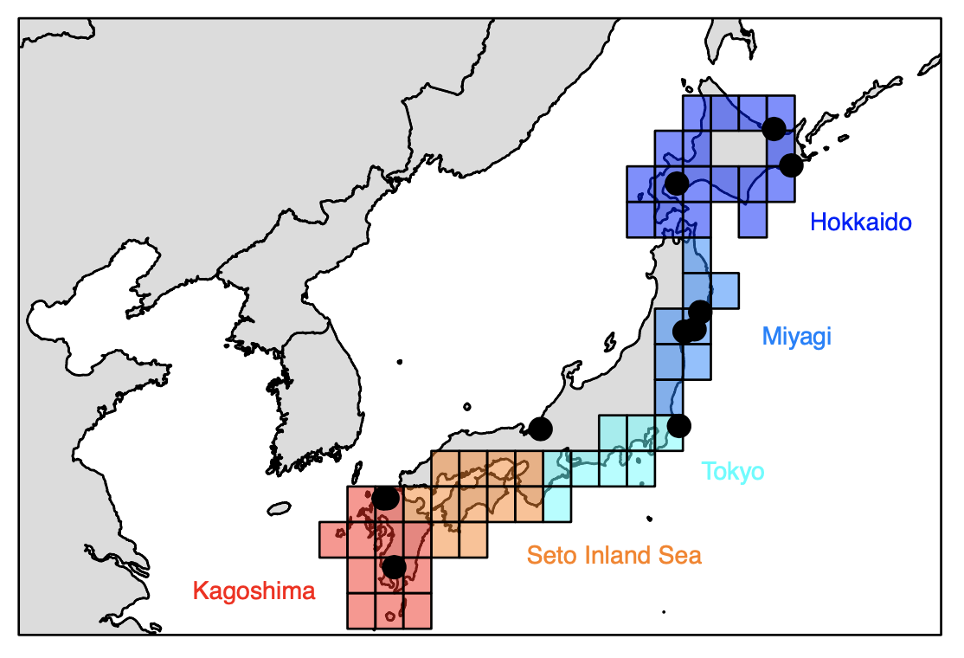
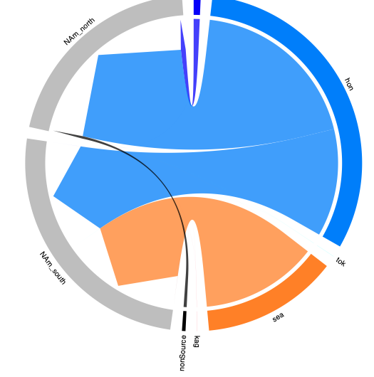
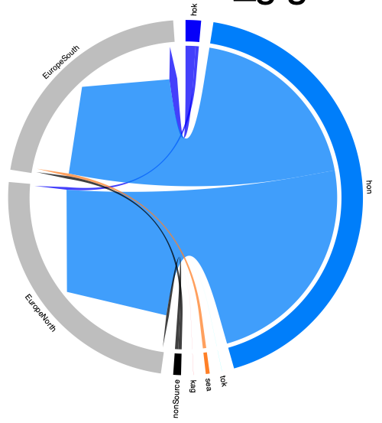
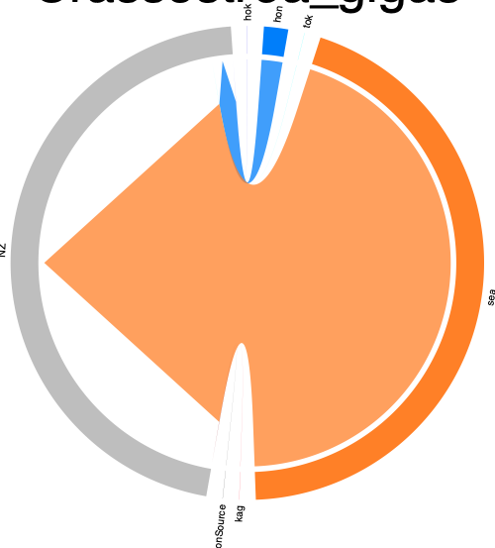
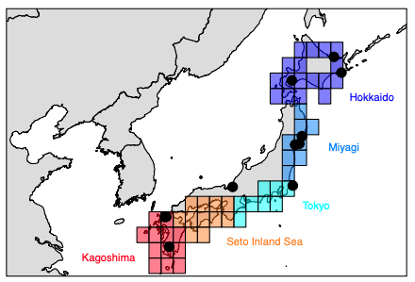
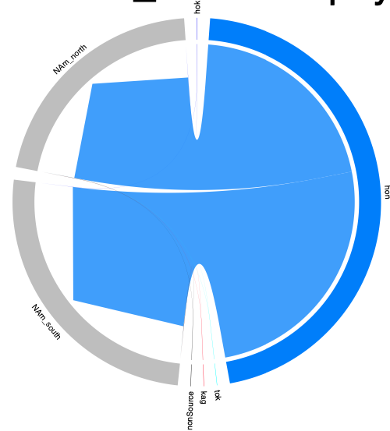
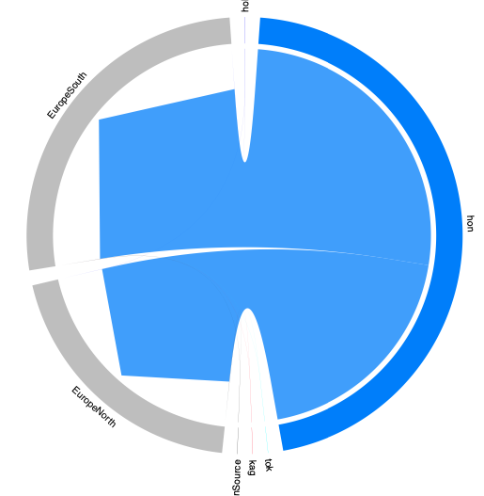
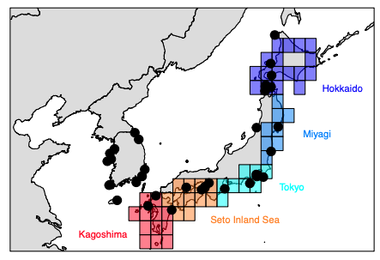
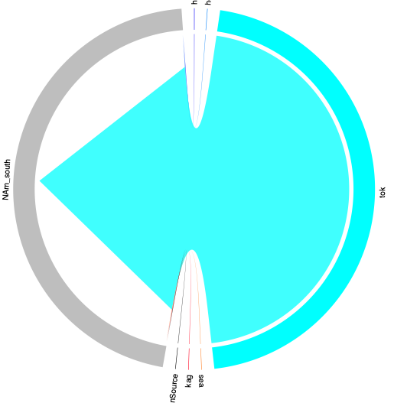
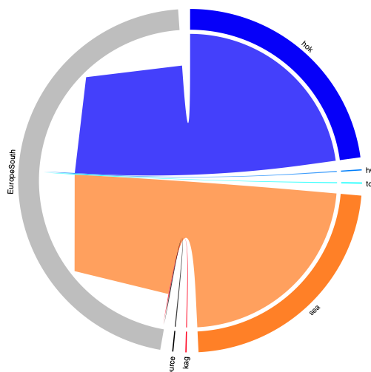
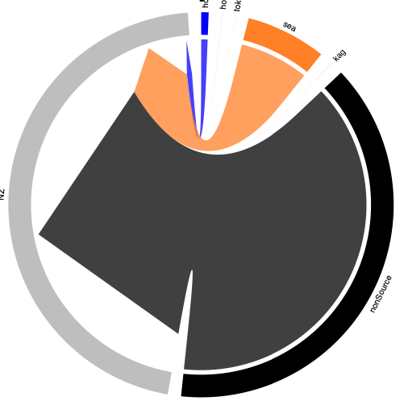
Western NA
Europe
New Zealand
Crassostrea gigas
Gracialaria
vermiculophylla
Undaria pinnitifida

Slide 11
Other

Slide 12
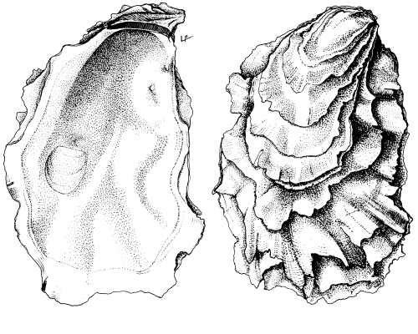
Photo credit FAO

Slide 13
North America
Europe
NZ
N
S
N
S
Crassostrea
gigas
Undaria
pinnatifida
Didemnum
vexillum
Gracilaria
vermiculophylla
Haminoea
japonica
Batillaria
attramentaria
Cercaria
batillaria (HL1)
Cercaria
batillaria (HL6)
Mutimo
cylindricus
Hemigrapsus
takanoi
Hemigrapsus
sanguineus

Slide 14
North America
Europe
NZ
Proposed
Vector
N
S
N
S
Shipping logs
1950-2014
NA
Crassostrea
gigas
NA
Undaria
pinnatifida
Aquaculture⁶
Didemnum
vexillum
Boat and oyster⁵
Gracilaria
vermiculophylla
Oyster¹
Haminoea
japonica
Oyster³
Batillaria
attramentaria
Oyster²
Cercaria
batillaria (HL1)
Birds²
Cercaria
batillaria (HL6)
Oyster²
Mutimo
cylindricus
Boat⁴
Hemigrapsus
takanoi
UNK
Hemigrapsus
sanguineus
Boat⁷
Notes:
1-Flanagan et al 2021; Krueger-Hadfield et al. 2017;
2-Miura et al. 2005;
3-Hanson et al. 2003;
4-https://invasions.si.edu/nemesis/calnemo/species_summary/11142
5-https://invasions.si.edu/nemesis/calnemo/species_summary/-334
6-https://invasions.si.edu/nemesis/calnemo/species_summary/-21
7-https://invasions.si.edu/nemesis/species_summary/-2

Slide 15
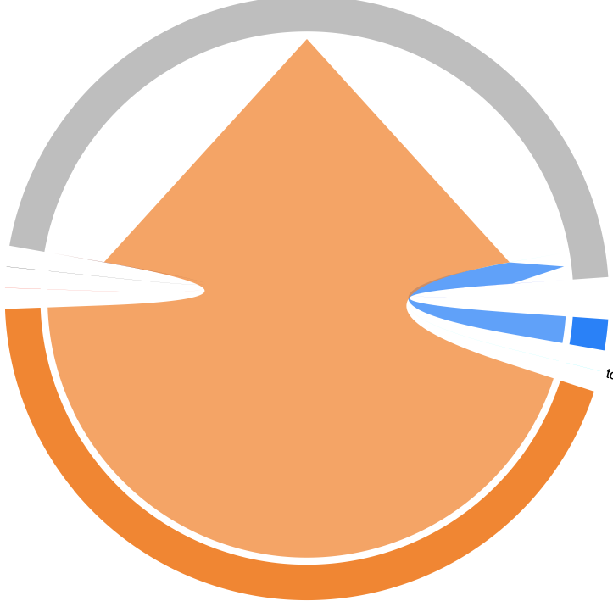
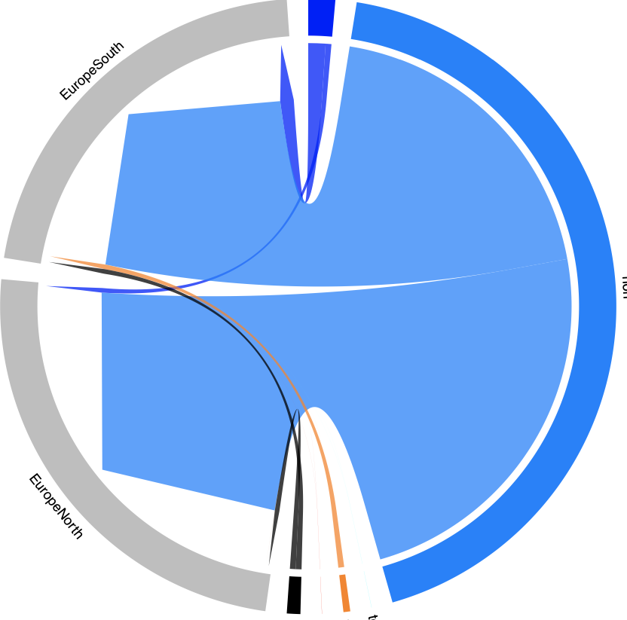
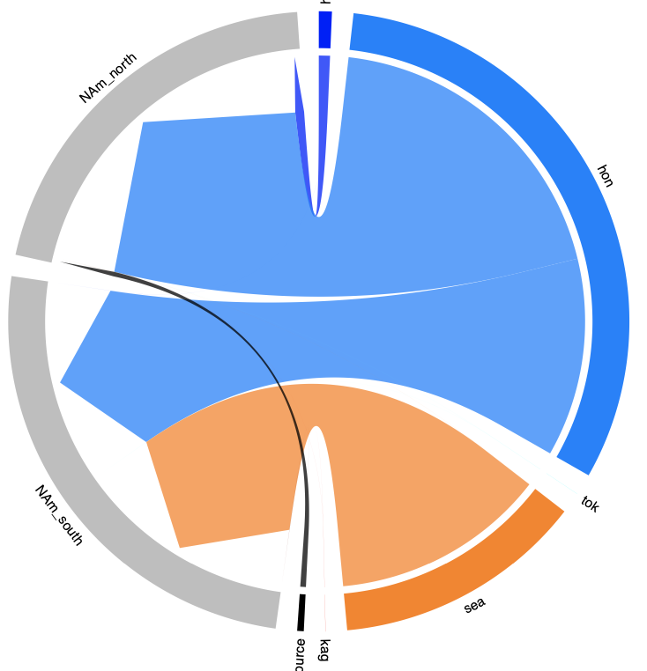
New Zealand
Seto Inland Sea
Europe
North America
North
Canada
WA
South
California
Seto
Miyagi
Miyagi
ADD SOUTH AMERICA

Slide 16
North America
California
Canada & WA
Miyagi
New
Zealand
Sp & Fr
Europe
UK, De, G, Sw
Seto
Inland
Sea
Ch
Arg
South
America
Figure 2. Top panel: Map of regions used for unsupervised machine learning. Bottom panel: A circlize plot that summarizes the native regions that non-native individuals most likely assign to. UK = United Kingdom, De = Denmark, G = Germany, Sw = Sweden, Sp = Spain, Fr = France, WA = Washington State, Ch = Chile, Arg = Argentina

Slide 17
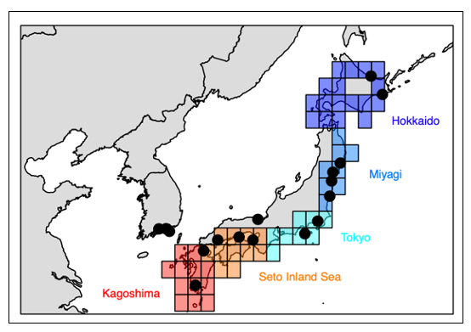
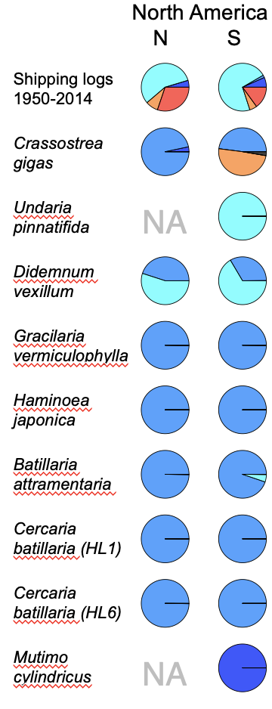
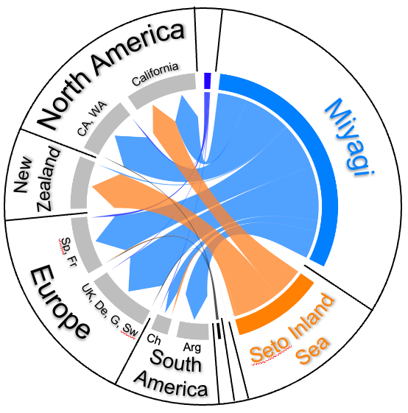
Figure 2. A) Map of C. gigas sampling within five regions of Japan (Hokkaido, Miyagi, Tokyo, Seto Inland Sea and Kagoshima) versus other sites (western Japan and South Korea). B) A circlize plot of source regions for non-native populations (from ML analysis). C) Pie charts of source regions for non-native populations (from ML analysis) of C. gigas and several putatively co-introduced species. As a means of comparison, a pie chart of the shipping activity that
A.
C.
Tokyo
B.

Slide 18
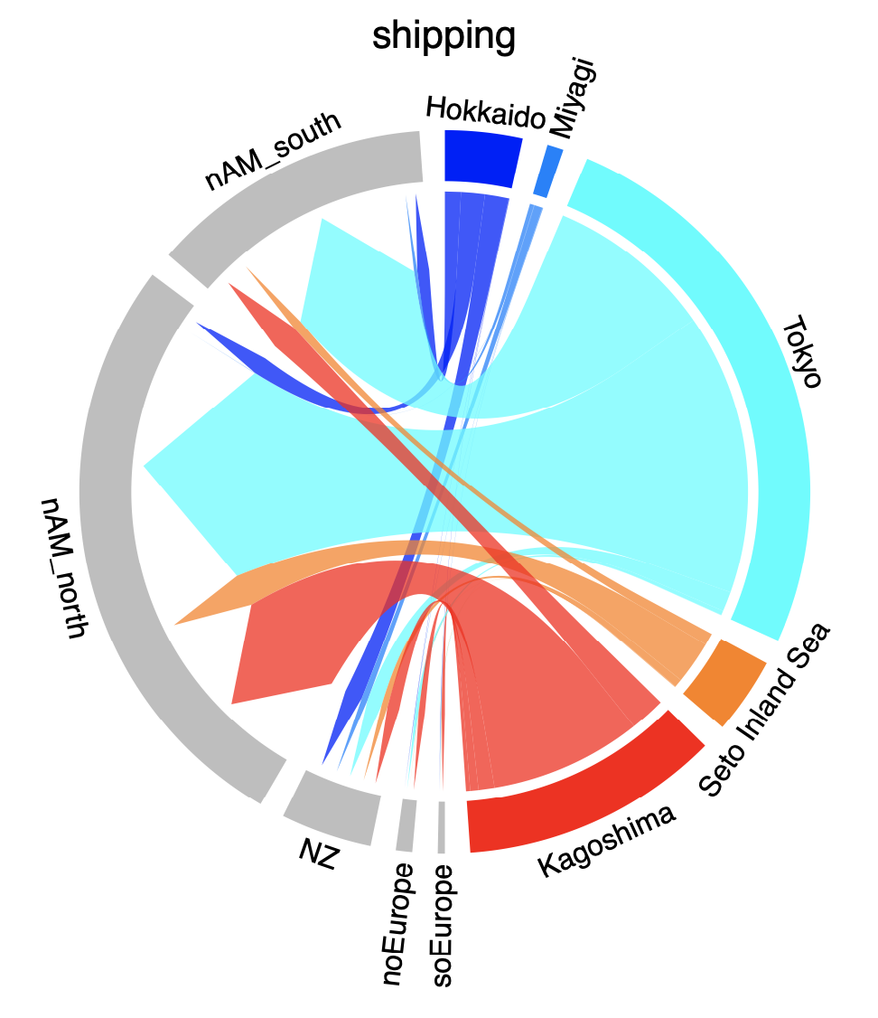
Pacific Oyster vector
Shipping vector

Slide 19
North America
California
Canada & WA
Miyagi
New
Zealand
Sp & Fr
Europe
UK, De, G, Sw
Seto
Inland
Sea
Ch
Arg
South
America

